Slide 1
Picking Up The Python Pace
Unit 3.2
Cybersecurity Boot Camp |

Slide 2
Today’s Summary
Data
Numbers
Strings
Booleans
Lists
Dictionaries
Logic
Operators
Conditionals
Loops
Functions
Modules

Slide 3
Today (Spoilers)
Data
Numbers
Strings
Booleans
Lists
Dictionaries
Logic
Operators
Conditionals
Loops
Functions
Modules
. . . plus more practice and application of what we’ve learned so far!

Slide 4
Today’s Goals
By the end of class, you will be able to:
Use simple and complex conditionals to create branching paths for programs to execute.
Build a command-line application using conditionals and user input.
Use for and while loops to iterate through lists and dictionaries to perform basic operations on collections of data.
Use the range function to loop through a list with defined ranges.
Use the enumerate function to loop through a list with a built-in counter.
Use key, value, and item methods with loops to convert data from dictionaries into lists.

Slide 5
Warm-up

Slide 6
Activity: Doling Out Data Types (12 min)
Instructions:
Declare a variable called name, and store your name inside it.
Print the message: "My name is *YOUR NAME HERE*."
Declare a variable called age, and store your age inside it.
Print the message: "I am *YOUR AGE HERE* years old."
Declare a variable called pizza_price, and store a number inside it.
Declare a variable called number_of_pizzas, and store a number inside it.
Store the total price for all the pizzas in a variable called total_price_of_pizzas.
Print the message: "The price of pizza is *PRICE OF PIZZA* dollars."
Print the message: "We are buying *NUMBER OF PIZZAS* pizzas."
Print the message: "The total price for all the pizzas is *TOTAL PRICE OF PIZZAS*."
Create a list, called favorite_countries. Store the name of four favorite countries inside it.
Print the message: "My favorite countries are *LIST OF COUNTRIES HERE*."
Create a dictionary called contact_information and store a home phone number, a cellphone number, and an email address inside of it.
Print out the message: "Please contact me at *EMAIL* or call me at *HOME PHONE*"
Print out the message: "In case of an emergency call *CELL NUMBER*"

Slide 7
Doling Out Data Types
Instructor Review

Slide 8
Conditionals

Slide 9
Conditionals
Conditionals are used everywhere in code. They are used to only run certain code if some condition is met.
Condition to be tested
The parenthesis and colons are just syntax to let Python know you’re building a conditional statement
Keyword
if
(x == 1):
# code to run if condition is true

Slide 10
Conditionals
The condition inside of the parenthesis is evaluated.
If the result of the evaluation is true, then the code block will run.
If the result of the evaluation is false, the code skips the block statement associated with that if statement, and continues running through the code.
if
(x == 1):
# code to run if condition is true

Slide 11
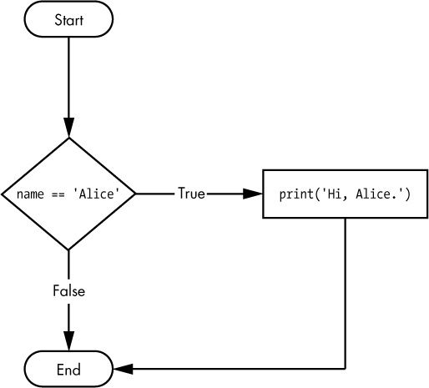
Conditionals
if
(name == “Alice”):
print(“Hi, Alice.”)
Assigning name == "Alice" before the if statement, this branch runs (print)
Assigning name == "Julia" before the if statement, this branch runs (no print)

Slide 12
Conditionals
if statements get more complicated: if…else
else—if none of the above is true, run this block of code.
if
(x == 1):
# code to run if condition is true
else
# code to run if none of the above conditions are true

Slide 13
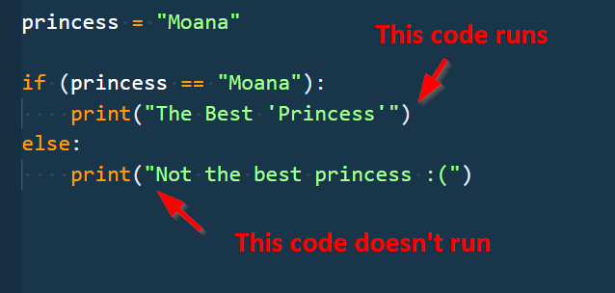
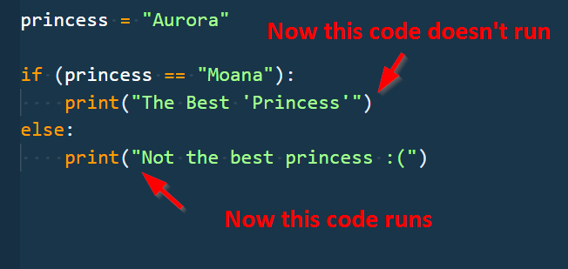
Conditionals

Slide 14
Activity: Password Check (7 min)
Use the PasswordCheck.py file to create a command-line app that asks users for their password as follows:
If the password matches the value stored within the master_password variable, alert the user with a message stating: "You have been granted access!"
If the password does not match the value stored within the master_password, alert the user with a message stating: "You have been denied access!"

Slide 15
Password Check
Instructor Review

Slide 16
Complex Conditionals
Notes:
Use the ComplexConditions.py file to demo complex conditionals for students.

Slide 17
Activity: Bad Bartending (15 min)
Create a digital bartender app by doing the following:
Set a variable called drinking_age to 21.
Prompt the user for their age in years and then check if the user is 21 or older.
If the user is 21 or older, create a list called drinks and store the names of four cocktails inside of it. Then prompt the user for the drink they want, check if the user's selection is in drinks list, and print "Cheers!" to the terminal if it is.
If the user is not 21 or older, print "your fake looks really fake" to the terminal instead.

Slide 18
Bad Bartending
Instructor Review

Slide 19
Loops

Slide 20

Back to The Zoo Pen
List Name: zoo_animals
Zebra
Rhino
Giraffe
Owl
Index 0
Index 1
Index 2
Index 3
Coded in Python using a List

Slide 21
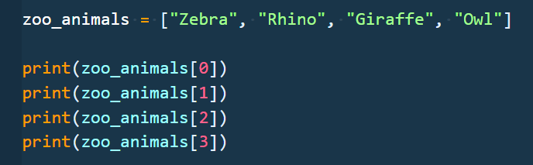
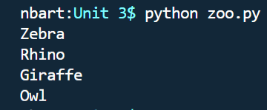
Back to The Zoo Pen (Logging)
List Name: zoo_animals
Zebra
Rhino
Giraffe
Owl
Index 0
Index 1
Index 2
Index 3

Slide 22
99 Loop Problem
What’s wrong here?

Slide 23
99 Loop Problem
Repeated Code!
We can be more efficient
Notes:
Imagine having to write all of that out for a list with 100 elements

Slide 24
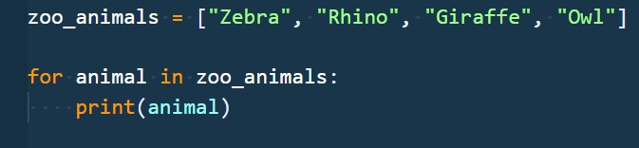
Enter the Loop
Loops are critical in programming.
Loops allow you to run a block of code multiple times.
Before:
After:

Slide 25
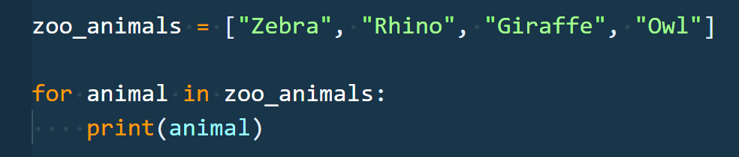
For Loop Breakdown
for loops are used to iterate over items of any sequence (e.g., list, string) in order.
For each iteration of the loop, the iteration variable (animal) gets set to the associated element in the list.
Code “inside” the for loop (indented) is the code block that gets executed once for each item in the sequence (4 times here).
Sequence
Block of Code
Iteration Variable

Slide 26
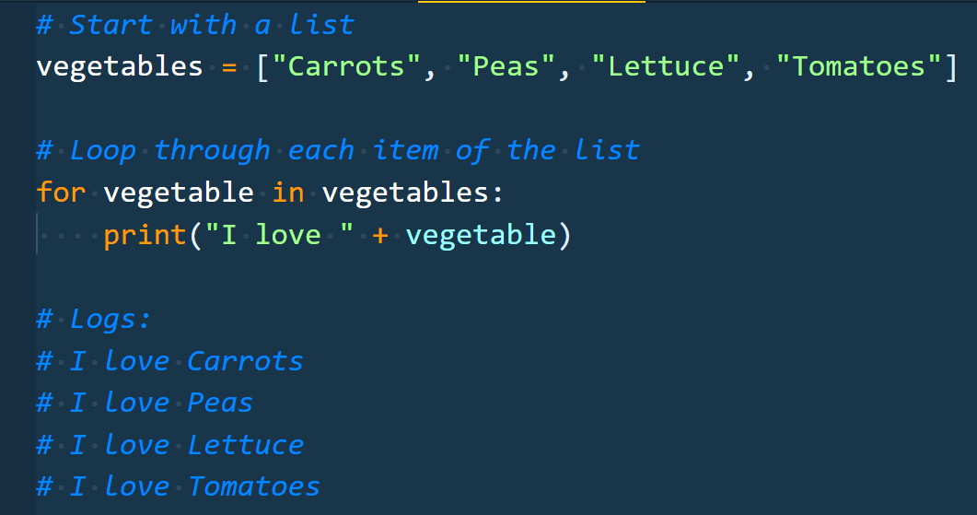
Enter the For-Loop
The indented code gets repeated for each item in the list

Slide 27
Enter the For-Loop
Running the code “loops” through and prints each item in the list.

Slide 28
Run That For Loop
For the first iteration, the loop sets vegetable = "Carrots"
Carrots
Peas
Lettuce
Tomatoes
Index 0
Index 1
Index 2
Index 3

Slide 29
Run That For Loop
For the first iteration, the loop sets vegetable = "Carrots"
So . . . print("I love Carrots")
Carrots
Peas
Lettuce
Tomatoes
Index 0
Index 1
Index 2
Index 3

Slide 30
Run That For Loop
For the second iteration, the loop sets vegetable = "Peas"
Carrots
Peas
Lettuce
Tomatoes
Index 0
Index 1
Index 2
Index 3

Slide 31
Run That For Loop
For the second iteration, the loop sets vegetable = "Peas"
So … print("I love Peas")
Carrots
Peas
Lettuce
Tomatoes
Index 0
Index 1
Index 2
Index 3

Slide 32
Run That For Loop
For the third iteration, the loop sets vegetable = "Lettuce"
Carrots
Peas
Lettuce
Tomatoes
Index 0
Index 1
Index 2
Index 3

Slide 33
Run That For Loop
For the third iteration, the loop sets vegetable = "Lettuce"
So … print("I love Lettuce")
Carrots
Peas
Lettuce
Tomatoes
Index 0
Index 1
Index 2
Index 3

Slide 34
Run That For Loop
For the fourth iteration, the loop sets vegetable = "Tomatoes"
Carrots
Peas
Lettuce
Tomatoes
Index 0
Index 1
Index 2
Index 3

Slide 35
Run That For Loop
For the fourth iteration, the loop sets vegetable = "Tomatoes"
So … print("I love Tomatoes")
Carrots
Peas
Lettuce
Tomatoes
Index 0
Index 1
Index 2
Index 3

Slide 36
Run That For Loop
We’ve now looped through the entire sequence.
Carrots
Peas
Lettuce
Tomatoes
Index 0
Index 1
Index 2
Index 3

Slide 37
Run That For Loop
We’ve now looped through the entire sequence. So the code skips forward to continue running code after the for loop.
Carrots
Peas
Lettuce
Tomatoes
Index 0
Index 1
Index 2
Index 3

Slide 38
Range and Enumerate

Slide 39
Activity: Vulnerable List (10 min)
You will create two for loops to navigate through a list of vulnerable IP addresses.
Using the file provided, do the following:
Create a loop using range() that moves through only the first 5 IP_addresses and prints them in order to the screen with their rank
Create a loop using enumerate() that goes through all of the IP_addresses and prints out the vulnerability ranking for each one
Hint: The ranking for an IP address is determined by its position in the list. The first element has the ranking of 1, the second has the rank of 2, and so on.

Slide 40
Vulnerable List
Instructor Review

Slide 41
Break! (15 minutes)

Slide 42
Nested for Loops

Slide 43
Activity: Programmer Loop (7 min)
In this activity, you are given a short list of dictionaries of people who work as programmers and must print out all the key/value pairs for each programmer using a series of nested for loops.
Send the students the following file and instructions over Slack:
File: ProgrammerLoop.py
Instructions:
Using the list of dictionaries in the file provided, do the following:
Loop through the programmers_list one dictionary at a time.
Loop through each of the dictionary's keys and values.
Print out each key and its associated value to the terminal.
Print out a line which will separate each programmer from the next.

Slide 44
Programmer Loop
Instructor Review

Slide 45
While Loops

Slide 46
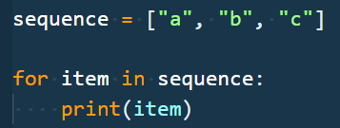

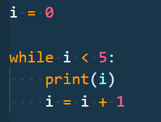

For vs While
For loops allow you run a block of code for each item in a sequence.
While loops allow you to run while some condition is true

Slide 47
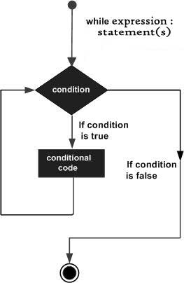
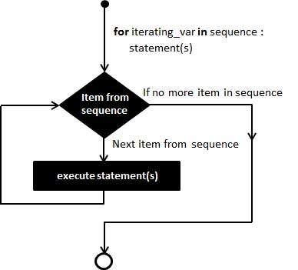
For vs While
Notes:
If you don't have a tidy data structure to iterate through, or you don't have a generator function that drives your processing, you must use while loop.
For while loops, the “break” condition does not depend on a sequence or predicable interaction.
https://stackoverflow.com/questions/920645/when-to-use-while-or-for-in-python

Slide 48
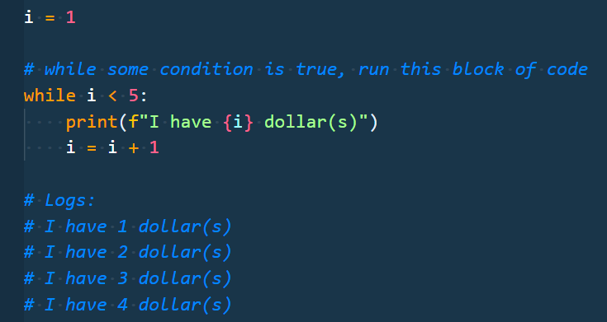
Run That While Loop
i = 1
i starts at 1

Slide 49

Run That While Loop
i = 1
1 < 5 - >True
We check the condition to see if the block of code will run.
Because i < 5 (i is 1), we will run the block of code

Slide 50
Run That While Loop
i = 1
1 < 5 - > True
print
The block of code prints and then increments our iterator variable i

Slide 51
Run That While Loop
i = 1
1 < 5 - > True
print
i = i + 1 -> 2
The block of code prints and then increments our iterator variable i

Slide 52
Run That While Loop
i = 1
1 < 5 - >True
print
i = 2
At the end of the code block, we go back to the top of the while loop.

Slide 53
Run That While Loop
i = 2
2 < 5 - >True
print
i = 3
Now i is 2, which is still less than 5, so the code block gets executed again and i is incremented to 3.
This process continues until the condition is False, i.e., when i >= 5.

Slide 54
Run That While Loop
i = 2
2 < 5 - >True
print
i = 3
Now i is 2, which is still less than 5, so the code block gets executed again and i is incremented to 3.
This process continues until the condition is False, i.e., when i >= 5.

Slide 55
Run That While Loop
i = 3
3 < 5 - >True
print
i = 4
This process continues until the condition is False, i.e., when i >= 5.

Slide 56
Run That While Loop
i = 3
3 < 5 - >True
print
i = 4
This continues until the condition is False, i.e., when i >= 5.

Slide 57
Run That While Loop
i = 4
4 < 5 - >True
print
i = 5
This continues until the condition is False, i.e., when i >= 5.

Slide 58
Run That While Loop
i = 4
4 < 5 - >True
print
i = 5
At the end of this loop iteration, i will be 5.

Slide 59

Run That While Loop
i = 5
5 < 5 - > False
Now i is 5, which is not less than 5, so the code block in the while loop won’t get executed again.
At this point, the code would continue running any code after the while loop and our loop iteration is finished.

Slide 60
Activity: The Number Chain (15 min)
In this activity, you will build a command-line game that will ask the user for a number and then will print all the numbers from 0 up until that number.
Ask the user "How many numbers?" and then print out a chain of ascending numbers from 0 up to, but not including, the number input.
After the results have printed, ask the user if they would like to continue. If "y" is entered, keep the chain running by inputting a new number and starting a new count from 0 to the number input. If "n" is entered, exit the application.
Hint: You will need to use both for and while loops for this activity.
Bonus: Rather than just displaying numbers starting at 0, have the numbers begin at the end of the previous chain.

Slide 61
The Number Chain
Instructor Review
Notes:
Review goals; address any questions.

Slide 62
Activity: Kid in a Candy Store (20 min)
In this activity, you are a kid in a candy store with your parents. Do the following:
Print out the list of candies provided to you in the file along with their index numbers stored in brackets beside them.
To do this, create a loop that prints all of the candies in the store to the terminal with their index stored in brackets beside them. Example: "[0] Snickers".
Then print out a prompt that asks “Which candy would you like to bring home?” The user will have to input the index associated with the candy. This prompt will run until all 5 choices have been made.
To do this, create a loop that runs for a number of times as determined by the variable allowance. Example: If allowance is equal to five, the loop should run five times.
Each time this second loop runs, take in a user's input, preferably a number, and then add the candy with a matching index to the variable candyCart. Example: If the user enters "0" as their input, "Snickers" should be added into the candyCart list.
Print out statement that says which candies the user brought home with them.
To do this, create another loop to print all of the candies selected to the terminal.
Bonus: Create a version of the same code which allows a user to select as much candy as they want up until they say they do not want any more.

Slide 63
Kid in a Candy Store
Instructor Review
Notes:
Review goals; address any questions.

Slide 64
Today
Data
Numbers
Strings
Booleans
Lists
Dictionaries
Logic
Operators
Conditionals
Loops
Functions
Modules
Notes:
Review goals; address any questions.

Slide 65
Today’s Goals
By the end of class, you will be able to:
Use simple and complex conditionals to create branching paths for programs to execute.
Build a command line application using conditionals and user input.
Use for and while loops to iterate through lists and dictionaries to perform basic operations on collections of data.
Use the range function to loop through a list with defined ranges.
Use the enumerate function to loop through a list with a built-in counter.
Use key, value, and item methods with loops to convert data from dictionaries into lists.
Use loops to iterate through lists and dictionaries to perform basic operations on collections of data.
Notes:
Review goals; address any questions.

Slide 66

Self-Check Up?
Stick around for office hours (or come early to the next class) if you have any questions or concerns!
We’re here to enable you to learn this stuff.
Remember: Sometimes learning can feel a lot like frustration!

